Slide 1
Capstone Project 2
Computer Vision for Self Driving Cars to detect traffic sign

Slide 2
Problem statement
The main objective is to create a deep learning model that detects traffic sign from German dataset.
The traffic sign is detected using the convoluted neural network.
A model is trained using the German traffic sign dataset.
I have used Tensorflow for model development and trained it on GPU.
The model is trained based on previously available dataset containing images of traffic signs and the neural network is used to predict the new traffic signs based on the training set.
The model is trained using the Adam Optimizer.

Slide 3
Data Collection
The data is a dictionary with 4 key/value pairs:
'features' is a 4D array containing raw pixel data of the traffic sign images, (num examples, width, height, channels).
'labels' is a 1D array containing the label/class id of the traffic sign. The file signnames.csv contains id -> name mappings for each id.
'sizes' is a list containing tuples, (width, height) representing the original width and height the image.
'coords' is a list containing tuples, (x1, y1, x2, y2) representing coordinates of a bounding box around the sign in the image. THESE COORDINATES ASSUME THE ORIGINAL IMAGE. THE PICKLED DATA CONTAINS RESIZED VERSIONS (32 by 32) OF THESE IMAGES

Slide 4
Data Collection
The model is trained based on previously available dataset containing images of traffic signs and the neural network is used to predict the new traffic signs based on the training set.
The model is trained using the Adam Optimizer.
There are several steps involved:
Load the data set
Explore, summarize and visualize the data set
Design, train and test a model architecture
Use the model to make predictions on new images
Analyze the softmax probabilities of the new images

Slide 5
Exploratory Data Analysis
The German dataset is visualized and random traffic signs are plotted and its count is also determined.
Number of training examples = 34799
Number of testing examples = 12630
Image data shape = (32, 32, 3)
Number of classes = 43
Here is an exploratory visualization of the data set. It is a bar chart showing how the data is distributed. We see that the distribution is uneven.

Slide 6
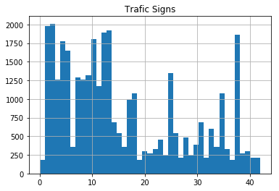
Exploratory Data Analysis
Traffic signs summary statistics: count 43.0 mean 809.0 std 627.0 min 180.0 50% 540.0 max 2010.0

Slide 7
Designing and testing the model architecture
Design and implementation of a deep learning model to recognize traffic signs.
The LeNet-5 implementation shows a solid starting point. I have changed the number of classes and preprocessing steps.
With the LeNet-5 solution I got a validation set accuracy of 0.946 and a test set accuracy of 0.942.
There are various aspects to consider when thinking about this problem:
Neural network architecture (is the network over or underfitting?)
Preprocessing techniques (normalization, rgb to grayscale, etc)
Number of examples per label (some have more than others)
Data augmentation - to generate fake data

Slide 8
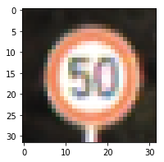
Designing and testing the model architecture
1. Pre-processing refers to techniques such as converting to grayscale, normalization
As a first step, I decided to convert the images to grayscale because the image color is not important. Also, I decided to implement normalisation, dividing the image by 255. Here is an example of a traffic sign image before gray-scaling with normalisation

Slide 9
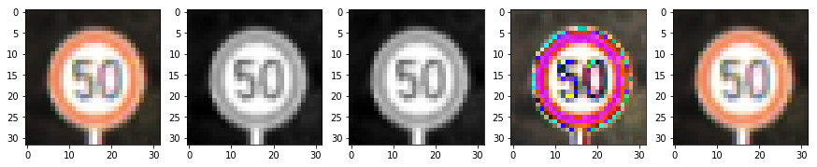
Designing and testing the model architecture
Here is an example of a traffic sign image after gray-scaling with normalisation. I tried different normalisation (diving by 255 and dividing by 128 after subtraction 128)
2. Set up training, validation and testing data.
My final training set had 34799 number of images. My validation set and test set had 4410 and 12630 number of images.

Slide 10
Designing and testing the model architecture
3. Training model.
To train the model, I used an AdamOptimizer.
Here are the following steps:
Run the training data through the training pipeline to train the model.
Shuffle the training set before each epoch
After each epoch, measure the loss and accuracy of the validation set.
Save the model after training.

Slide 11
Designing and testing the model architecture
4.The approach taken for finding a solution.
The final model results were:
validation set accuracy of 0.946
test set accuracy of 0.942
Steps to find final approach:
The first architecture that I was tried was LeNet Architecture. Sign recognition is similar to MNIST case, so i decided to try it.
LeNet was pretty good but validation accuracy was less than 90%. So, I decided to abandon it.
I tried different approaches: to include/exclude colors, to add more layers and etc. But the model was overfitting. So, I decided to stay with LeNet architecture, but to increase number of neurons in layers 3-4 times because we have more number of labels than in MNIST data (43 vs 10) and to protect model from overfitting I decided to add dropout after 2nd convolution layer with 50% keep ratio. It helped to increase accuracy to 94%.

Slide 12
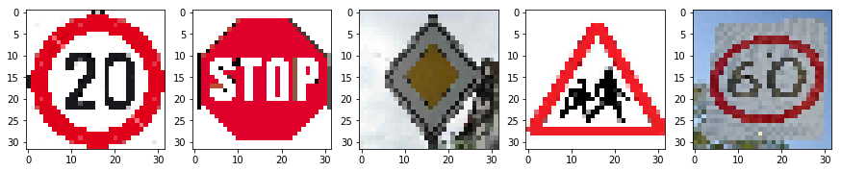
Test the Model on New Images
1. New five German traffic signs found on the web.
Here are five German traffic signs that I found on the web. They were in a much bigger resolution so, I used TF tf.image.resize_nearest_neighbor function to resize them to (32, 32) format.

Slide 13
Test the model on new images
The model was able to correctly guess 5 of the 5 traffic signs, which gives an accuracy of 100%. This compares favorably to the accuracy on the test set of 94.4%
Image | Prediction
Speed limit (100km/h) | Speed limit (100km/h)
Stop Sign | Stop Sign
Priority road | Priority road
Children crossing | Children crossing
Speed limit (60km/h) | Speed limit (60km/h)

Slide 14
Test the model on new images
3. Softmax probabilities for each prediction.
For each of the new images I printed out the model's softmax probabilities to show the certainty of the model's predictions (the output is limited up to top 5 probabilities for each image). tf.nn.top_k could prove helpful here.
tf.nn.top_k will return the values and indices (class ids) of the top k predictions. So if k=3, for each sign, it'll return the 3 largest probabilities (out of a possible 43) and the corresponding class ids.

Slide 15
Test the model on new images
Top 5 Probabilities for the prediction:
Image | Top-5 Probability
1 image | 1. 0. 0. 0. 0.
2 image | 1. 0. 0. 0. 0.
3 image | 1. 0. 0. 0. 0.
4 image | 1. 0. 0. 0. 0.
5 image | 0.82 0.07 0.06 0.02 0.01

Slide 16
Test the model on new images
Top 5 labels for the prediction:
Image | Top-5 Pred. Lab.
1 image | 0 1 29 38 4
2 image | 14 13 1 38 12
3 image | 12 40 35 13 15
4 image | 28 30 3 11 29
5 image | 3 2 40 16 5

